Slide 1
Document Management System
ระบบจัดการเอกสาร
Embedded System Laboratory, KMITL 2004

Slide 2
Advisor
Assoc. Prof. Apinetr Unakul
Chavalit Jintamalit 43010090
Natthakan Worakitpoonpol 43010126
Embedded System Laboratory, KMITL 2004

Slide 3
Section
Introduction
Design
Summary
Embedded System Laboratory, KMITL 2004

Slide 4
Objective
เพื่อศึกษา ออกแบบ และพัฒนาระบบการจัดการเอกสารในส่วนการไหลของงาน โดยใช้เทคโนโลยีจาวา และระบบฐานข้อมูล
Embedded System Laboratory, KMITL 2004

Slide 5
Benefits
ลดการใช้ทรัพยากร
การติดตามงานต่าง ๆ สามารถดำเนินการได้อย่างรวดเร็ว
การให้บริการต่าง ๆ ในองค์กร จะทำได้รวดเร็ว
Embedded System Laboratory, KMITL 2004

Slide 6
Development Tools
  J2SE 1.4
    Implement Web with JSP, JavaBeans technology
  Apache Tomcat 4.1
    Web server
  SQL Server 2000
    Database server
  Rational Rose
    Design UML of The System
Embedded System Laboratory, KMITL 2004

Slide 7
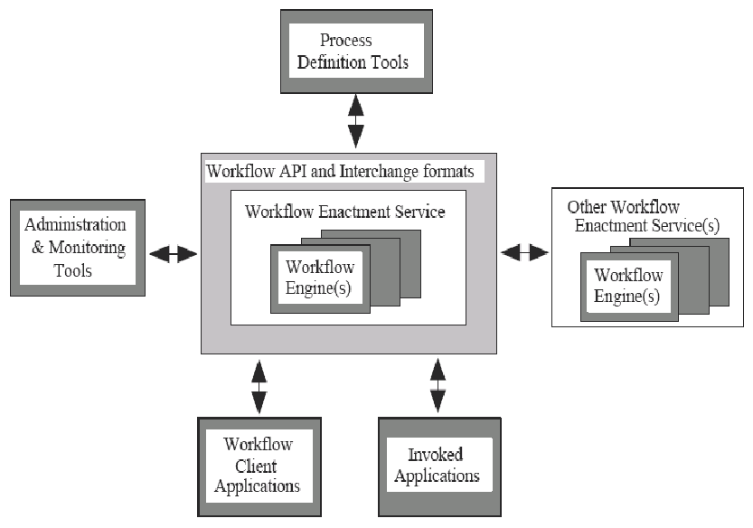
Workflow Model (Architecture)
Embedded System Laboratory, KMITL 2004

Slide 8
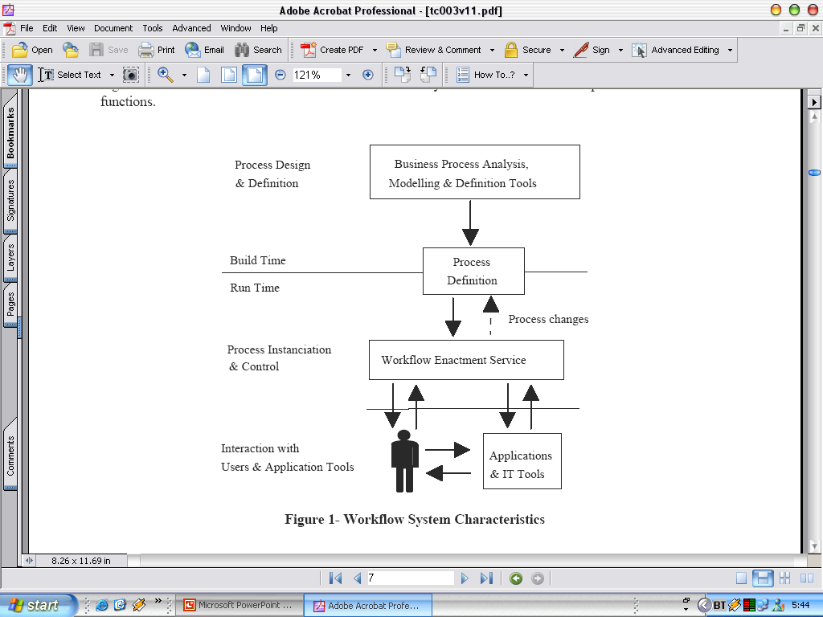
The Workflow Management Coalition Specification
Workflow System Characteristics
Embedded System Laboratory, KMITL 2004

Slide 9
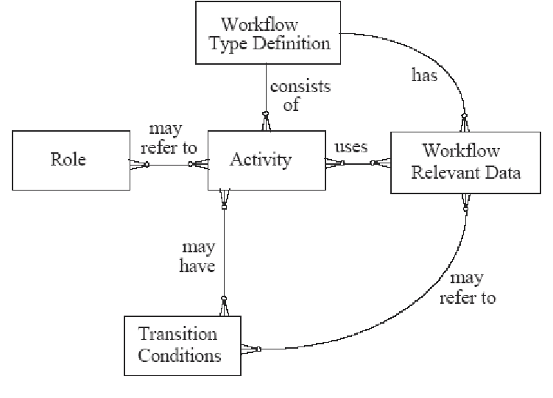
Process definition Model
Embedded System Laboratory, KMITL 2004

Slide 10
Design
Document Management System
Account Management
Workflow
Management
Tracking & Monitoring
Create & Handle
Work from
Wok list
- User
- Group
- Role
- Workflow
- Document type
View Performance
-Tracking and Forcing work
Take
Submit
Reject
Delete
Leave
(Edit User’s Profile)
Embedded System Laboratory, KMITL 2004

Slide 11
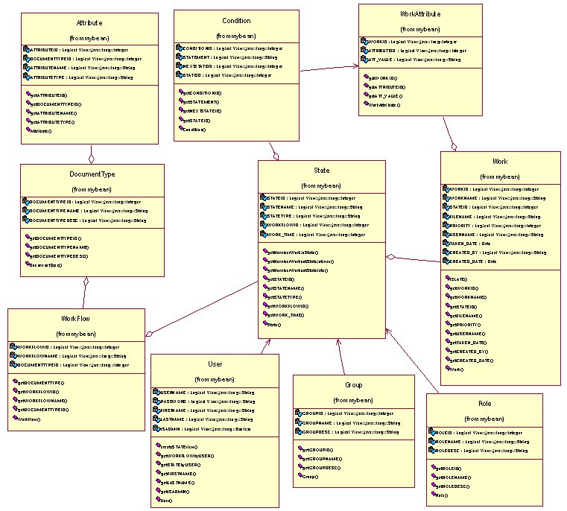
Class Diagram
Attribute
Condition
WorkAttribute
State
Work
DocumentType
Workflow
User
Group
Role

Slide 12
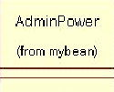
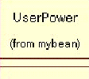
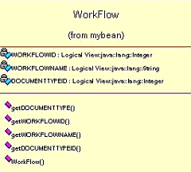
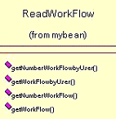
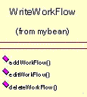
Class Diagram
+Readuser
+Writeuser
+Readuser
Embedded System Laboratory, KMITL 2004

Slide 13
Class Diagram
User | ReadUser | WriteUser
UserState | ReadUserState | WriteUserState
Group | ReadGroup | WriteGroup
GroupState | ReadGroupState | WriteGroupState
Role | ReadRole | WriteRole
RoleState | ReadRoleState | WriteRoleState
UserGroup | ReadUserGroup | WriteUserGroup
RoleUser | ReadRoleUser | WriteRoleUser
RoleGroup | ReadRoleGroup | WriteRoleGroup
DocumentType | ReadDocumentType | WriteDocumentType
Attribute | ReadAttribute | WriteAttribute
Workflow | ReadWorkflow | WriteWorkflow
State | ReadState | WriteState
Condition | ReadCondition | WriteCondition
Work | ReadWork | WriteWork
WorkAttribute | ReadWorkAttribute | WriteWorkAttribute
Logwork | ReadLogwork | WriteLogwork
Embedded System Laboratory, KMITL 2004

Slide 14
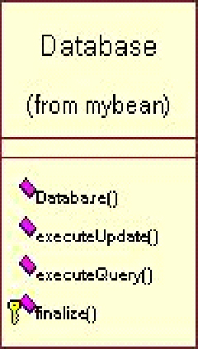
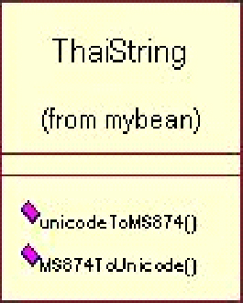
Class Diagram
Embedded System Laboratory, KMITL 2004

Slide 15
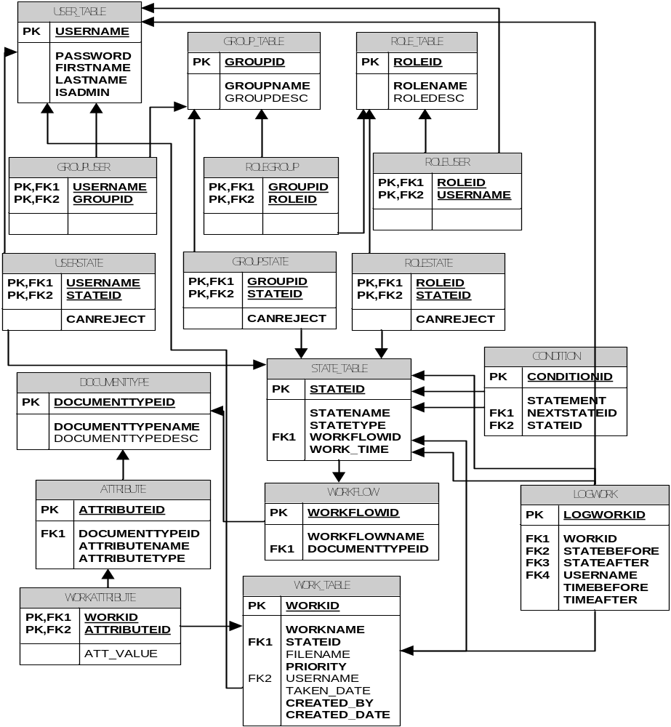
Relational Schema

Slide 16
The Workflow Management Coalition Specification
Workflow System Characteristics
Embedded System Laboratory, KMITL 2004

Slide 17
Process definition Model
Embedded System Laboratory, KMITL 2004

Slide 18
Process Design & Definition
Business Analysis
  Document Type & Attribute
  Workflow
  State
  State Transition Condition
  Authorization
Account Management
  Creating Role
  Mapping user(s) and group(s) Role

Slide 19
Process Design & Definition
Workflow Management (Admin Definition Tool)
  Creating Document Type
  Creating Workflow
    Creating State(s)
    Creating and Mapping Condition(s) to State
    Mapping user(s), group(s), role(s) to states

Slide 20
Scenario from Business Analysis
ใบสั่งซื้อสินค้า
ราคา
Embedded System Laboratory, KMITL 2004

Slide 21
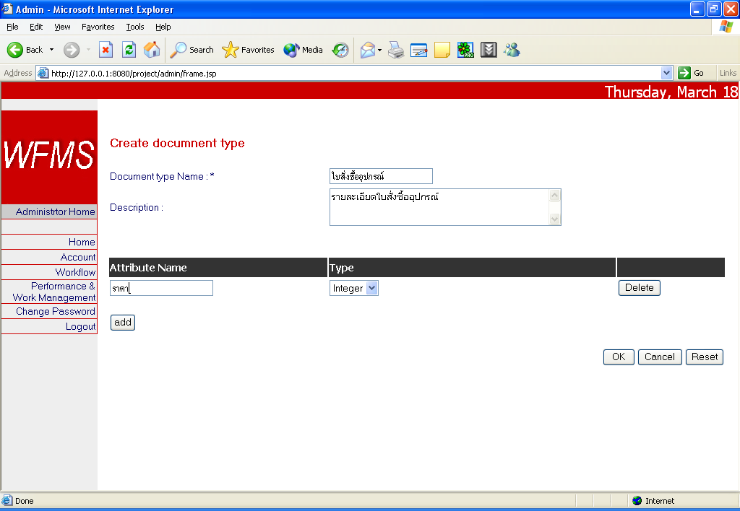
Workflow Management (Admin Definition Tool)
Creating Document Type
  Add Document Attribute
Embedded System Laboratory, KMITL 2004

Slide 22



Workflow Management (Admin Definition Tool)
Account Management
พนักงานทั่วไป
หัวหน้าฝ่าย
ผู้จัดการ
Embedded System Laboratory, KMITL 2004

Slide 23
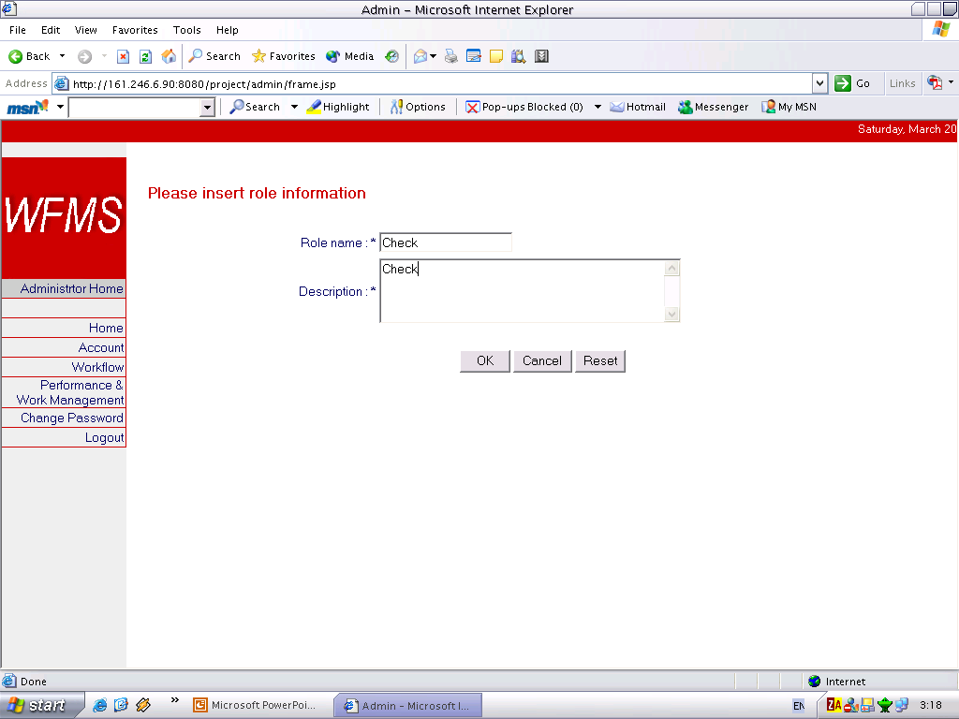
Workflow Management (Admin Definition Tool)
Account Management
Account Management
  Creating Role
  Mapping user(s) and group(s) Role
Embedded System Laboratory, KMITL 2004

Slide 24
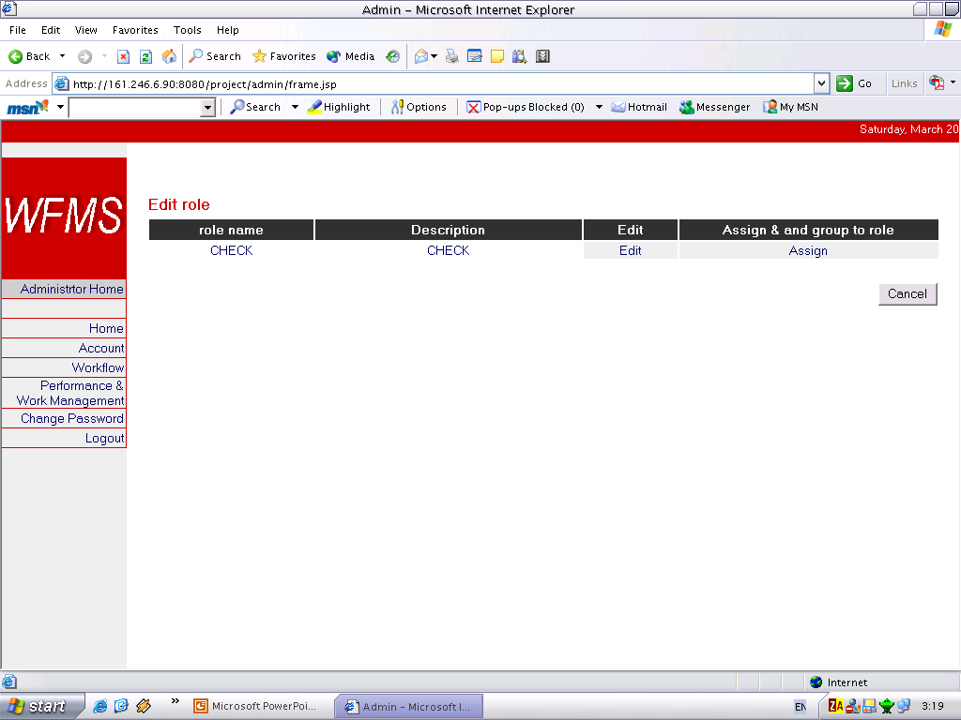
Workflow Management (Admin Definition Tool)
Account Management
Account Management
  Creating Role
  Mapping user(s) and group(s) Role
Embedded System Laboratory, KMITL 2004

Slide 25
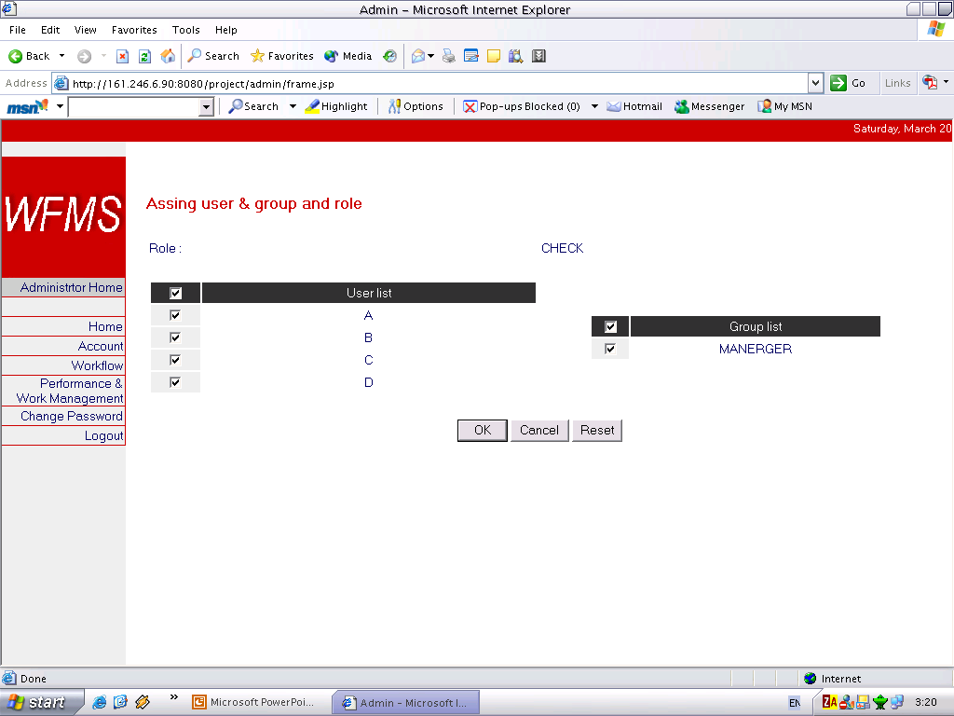
Workflow Management (Admin Definition Tool)
Account Management
Account Management
  Creating Role
  Mapping user(s) and group(s) Role
Embedded System Laboratory, KMITL 2004

Slide 26
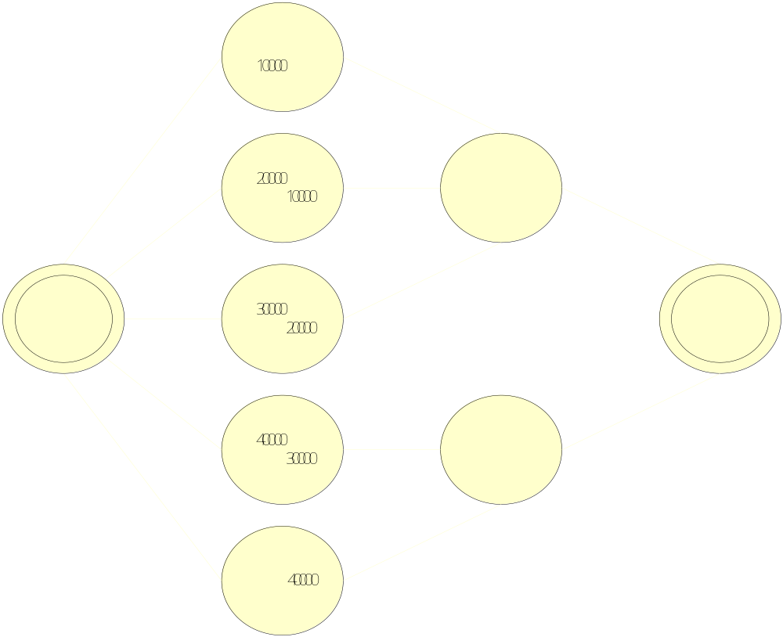
Scenario from Business Analysis
Embedded System Laboratory, KMITL 2004

Slide 27
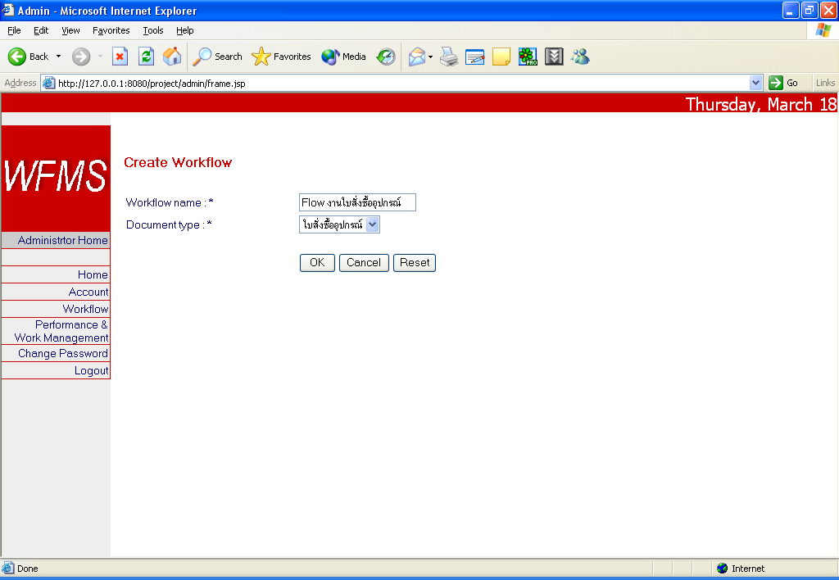
Workflow Management (Admin Definition Tool)
Process Definition
Creating Workflow
  Creating State(s)
  Creating Condition(s)
  Mapping user(s), group(s), role(s) to states
Embedded System Laboratory, KMITL 2004

Slide 28
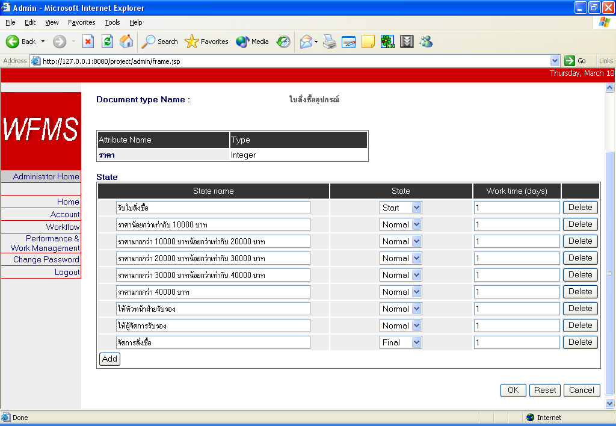
Workflow Management (Admin Definition Tool)
Process Definition
Creating Workflow
  Creating State(s)
  Creating Condition(s)
  Mapping user(s), group(s), role(s) to states
Embedded System Laboratory, KMITL 2004

Slide 29
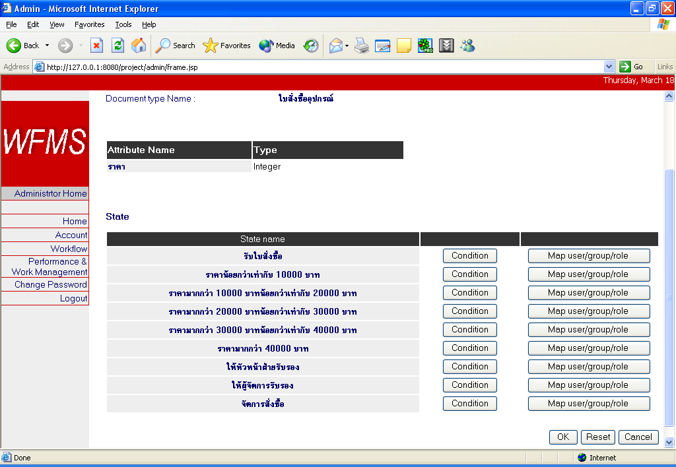
Workflow Management (Admin Definition Tool)
Process Definition
Creating Workflow
  Creating State(s)
  Creating Condition(s)
  Mapping user(s), group(s), role(s) to states
Embedded System Laboratory, KMITL 2004

Slide 30
Scenario from Business Analysis
ราคา <= 10000
ราคา > 10000 และ <= 20000
ราคา > 20000 และ <= 30000
ราคา > 30000 และ <=40000
ราคา > 40000
Embedded System Laboratory, KMITL 2004

Slide 31
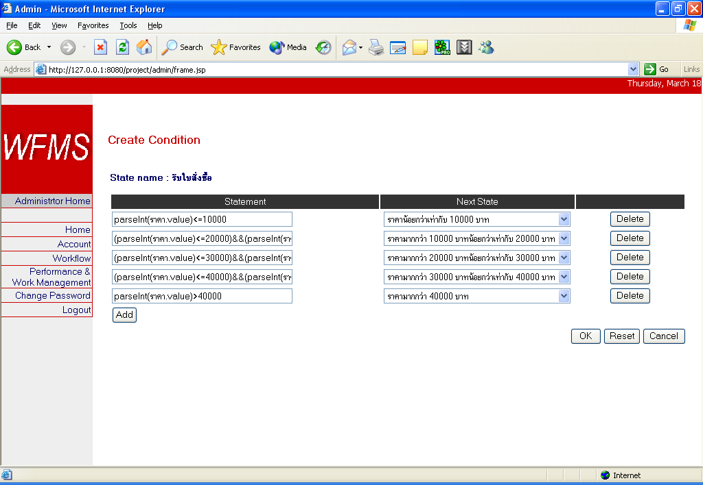
Workflow Management (Admin Definition Tool)
Process Definition
Creating Workflow
  Creating State(s)
  Creating Condition(s)
  Mapping user(s), group(s), role(s) to states
Embedded System Laboratory, KMITL 2004

Slide 32
Scenario from Business Analysis
ผู้รับผิดชอบงานใน State นี้ต้องเป็นเฉพาะหัวหน้าฝ่ายเท่านั้น
Embedded System Laboratory, KMITL 2004

Slide 33
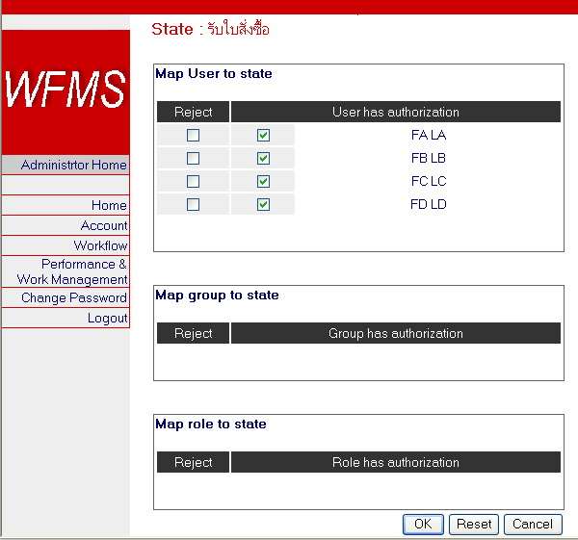
Workflow Management (Admin Definition Tool)
Process Definition
Creating Workflow
  Creating State(s)
  Creating Condition(s)
  Mapping user(s), group(s), role(s) to states
Embedded System Laboratory, KMITL 2004

Slide 34
The Workflow Management Coalition Specification
Workflow System Characteristics
Embedded System Laboratory, KMITL 2004

Slide 35
Workflow Enactment
Handling Works
  Creating Work
  Handling Works
    Reading values and document
    Taking work
    Submit work
    Leave work
    Reject work
    Terminate work

Slide 36
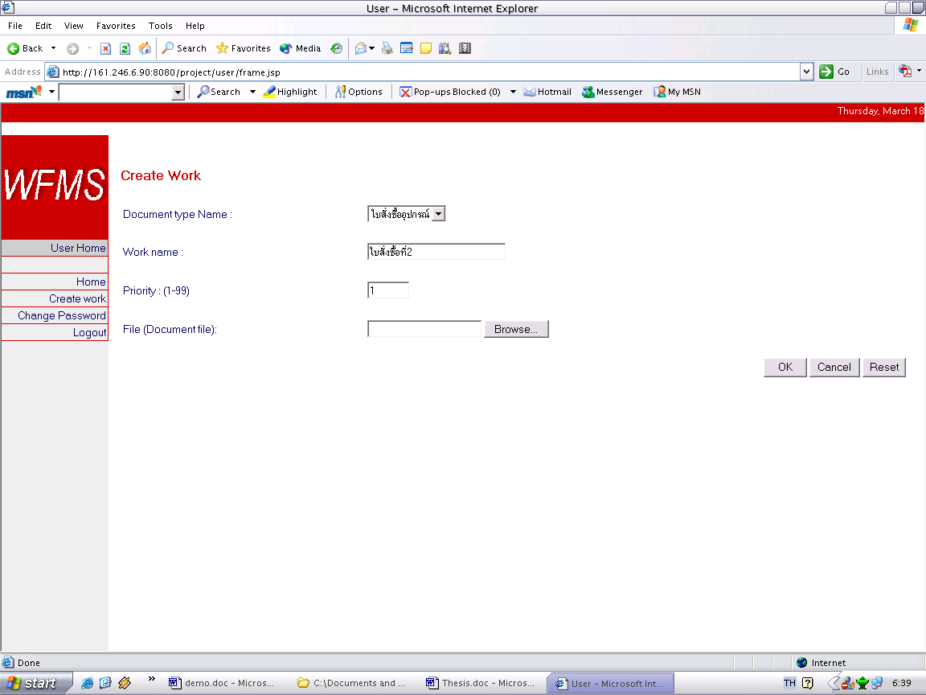
Handling Work (Creating work)
Handling Works
Creating Work
Handling Works
  Reading values & doc
  Taking work
  Submit work
  Reject work
  Leave work
  Terminate work
Embedded System Laboratory, KMITL 2004

Slide 37
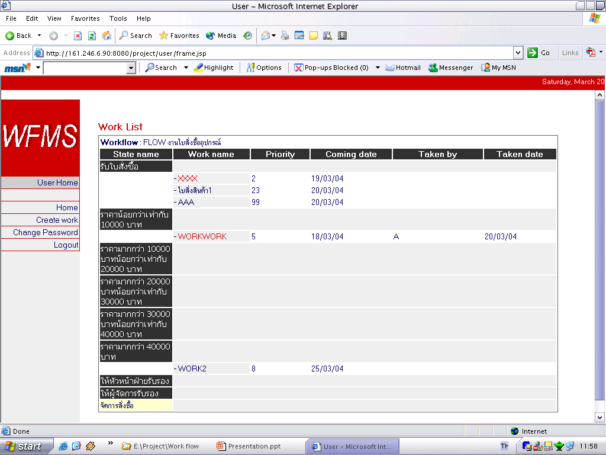
Handling Work (Handling work)
Handling Works
Creating Work
Handling Works
  Reading values & doc
  Taking work
  Submit work
  Reject work
  Leave work
  Terminate work
งานค้างเกินกำหนด ขึ้นตัวสีแดง
Embedded System Laboratory, KMITL 2004

Slide 38
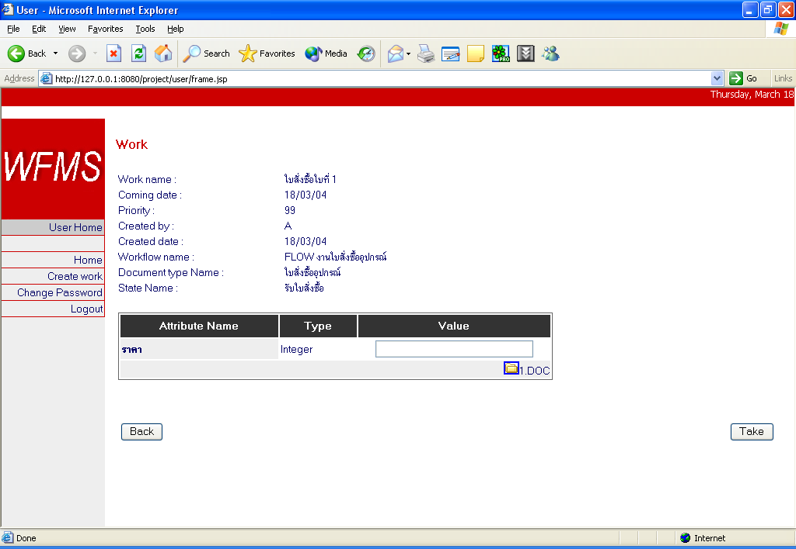
Handling Work (Handling work)
Handling Works
Creating Work
Handling Works
  Reading values & doc
  Taking work
  Submit work
  Reject work
  Leave work
  Terminate work
Download Document
Embedded System Laboratory, KMITL 2004

Slide 39
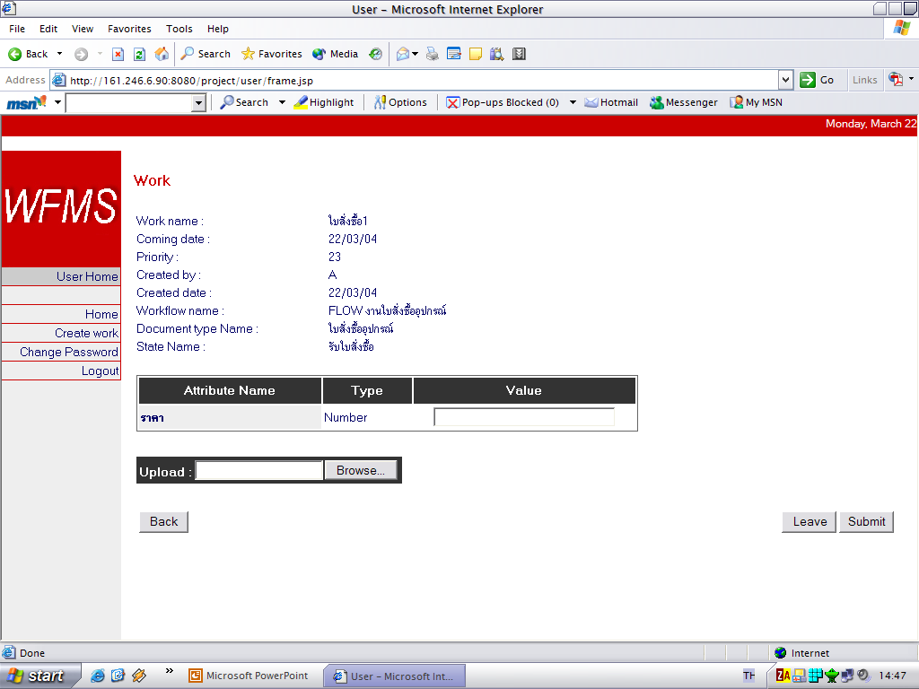
Handling Work (Handling work)
Handling Works
Creating Work
Handling Works
  Reading values & doc
  Taking work
  Submit work
  Reject work
  Leave work
  Terminate work
Embedded System Laboratory, KMITL 2004

Slide 40
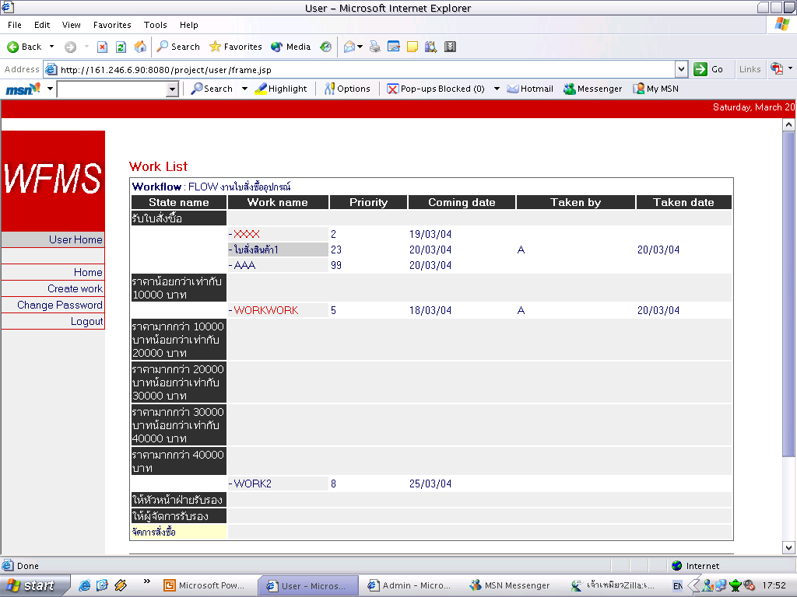
Handling Work (Handling work)
Handling Works
Creating Work
Handling Works
  Reading values & doc
  Taking work
  Submit work
  Reject work
  Leave work
  Terminate work
บอกชื่อผู้รับงานชิ้นนี้
Embedded System Laboratory, KMITL 2004

Slide 41
Handling Work (Handling work)
Handling Works
Creating Work
Handling Works
  Reading values & doc
  Taking work
  Submit work
  Reject work
  Leave work
  Terminate work
ก่อนจาก Submit งาน
Embedded System Laboratory, KMITL 2004

Slide 42
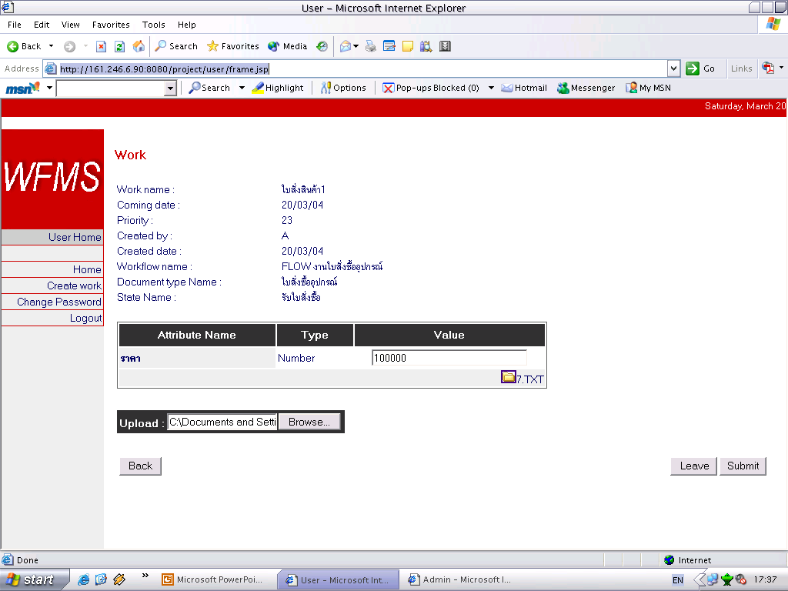
Handling Work (Handling work)
Handling Works
Creating Work
Handling Works
  Reading values & doc
  Taking work
  Submit work
  Reject work
  Leave work
  Terminate work
Upload เอกสารที่มีการเปลี่ยนแปลง
Embedded System Laboratory, KMITL 2004

Slide 43
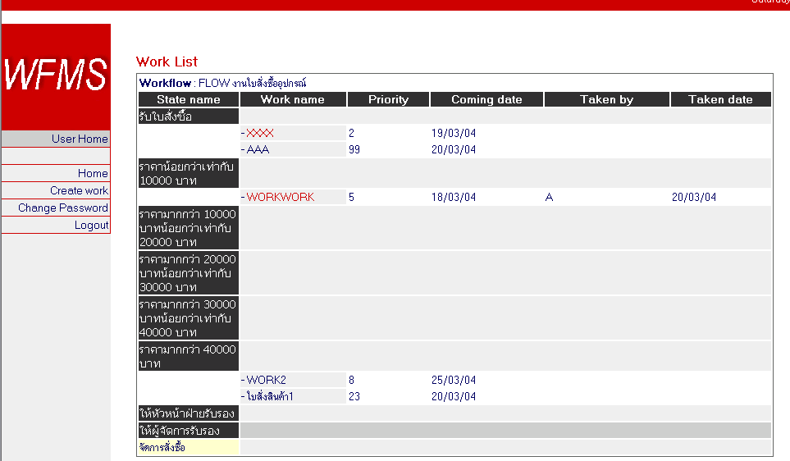
Handling Work (Handling work)
Handling Works
Creating Work
Handling Works
  Reading values & doc
  Taking work
  Submit work
  Reject work
  Leave work
  Terminate work
หลังจาก Submit งาน
Embedded System Laboratory, KMITL 2004

Slide 44
Handling Work (Handling work)
Handling Works
Creating Work
Handling Works
  Reading values & doc
  Taking work
  Submit work
  Reject work
  Leave work
  Terminate work
Embedded System Laboratory, KMITL 2004

Slide 45
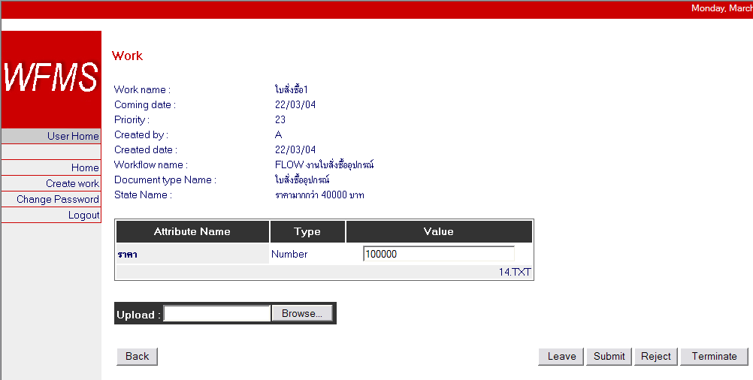
Handling Work (Handling work)
Handling Works
Creating Work
Handling Works
  Reading values & doc
  Taking work
  Submit work
  Reject work
  Leave work
  Terminate work
Embedded System Laboratory, KMITL 2004

Slide 46
Handling Work (Handling work)
Handling Works
Creating Work
Handling Works
  Reading values & doc
  Taking work
  Submit work
  Reject work
  Leave work
  Terminate work
งานกลับไป state ก่อนหน้า
Embedded System Laboratory, KMITL 2004

Slide 47
Handling Work (Handling work)
Handling Works
Creating Work
Handling Works
  Reading values & doc
  Taking work
  Submit work
  Reject work
  Leave work
  Terminate work
Embedded System Laboratory, KMITL 2004

Slide 48
Handling Work (Handling work)
Handling Works
Creating Work
Handling Works
  Reading values & doc
  Taking work
  Submit work
  Reject work
  Leave work
  Terminate work
Embedded System Laboratory, KMITL 2004

Slide 49
Handling Work (Handling work)
Handling Works
Creating Work
Handling Works
  Reading values & doc
  Taking work
  Submit work
  Reject work
  Leave work
  Terminate work
Embedded System Laboratory, KMITL 2004

Slide 50
Handling Work (Handling work)
Handling Works
Creating Work
Handling Works
  Reading values & doc
  Taking work
  Submit work
  Reject work
  Leave work
  Terminate work
Embedded System Laboratory, KMITL 2004

Slide 51
Tracking and Monitoring Tool
Performance
  Select Workflow
  Select state and time interval
  View Performance
Work Management
  Select Workflow
  Select State
  Force Work
Embedded System Laboratory, KMITL 2004

Slide 52
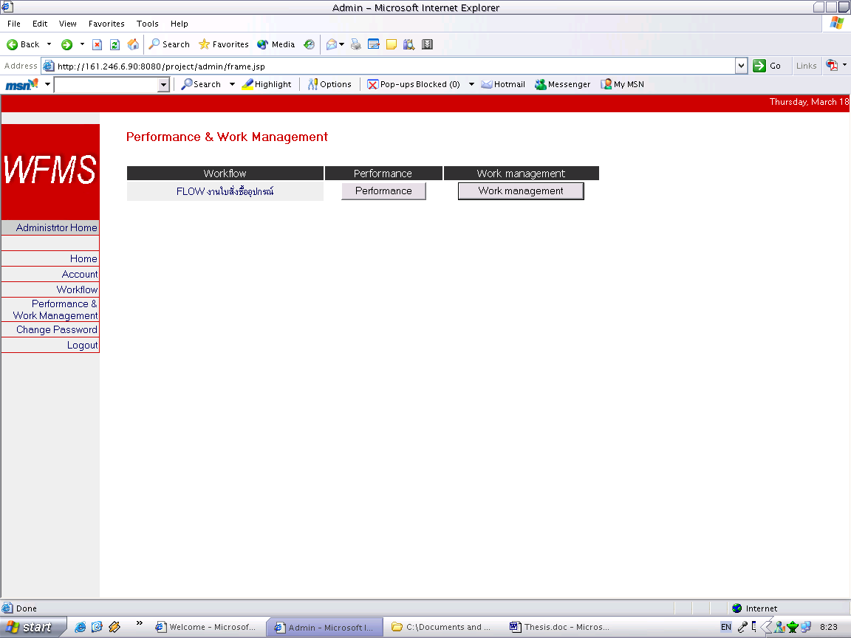
Tracking and Monitoring Tool
Monitoring Tool
Performance
  Select Workflow
  Select State & Time interval
  View Performance
Work Management
  Select Workflow
  Select State
  Force Work
Embedded System Laboratory, KMITL 2004

Slide 53
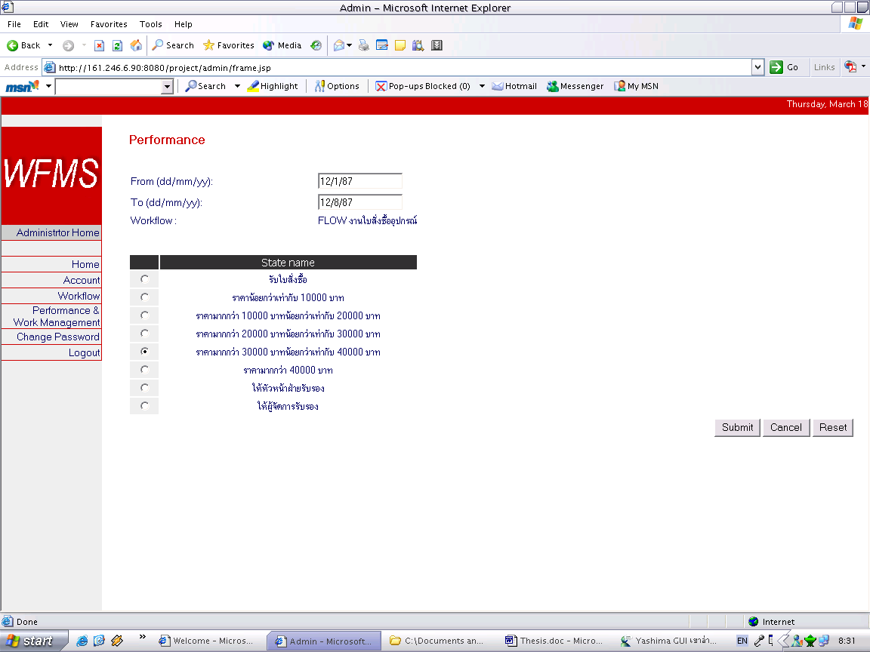
Tracking and Monitoring Tool
Monitoring Tool
Performance
  Select Workflow
  Select State & Time interval
  View Performance
Work Management
  Select Workflow
  Select State
  Force Work
Embedded System Laboratory, KMITL 2004

Slide 54
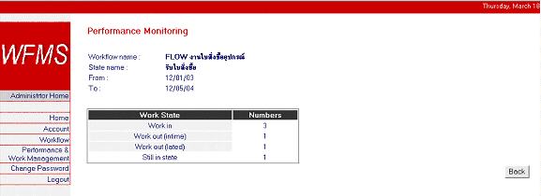
Tracking and Monitoring Tool
Monitoring Tool
Performance
  Select Workflow
  Select State & Time interval
  View Performance
Work Management
  Select Workflow
  Select State
  Force Work
Embedded System Laboratory, KMITL 2004

Slide 55
Tracking and Monitoring Tool
Monitoring Tool
Performance
  Select Workflow
  Select State & Time interval
  View Performance
Work Management
  Select Workflow
  Select State
  Force Work
Embedded System Laboratory, KMITL 2004

Slide 56
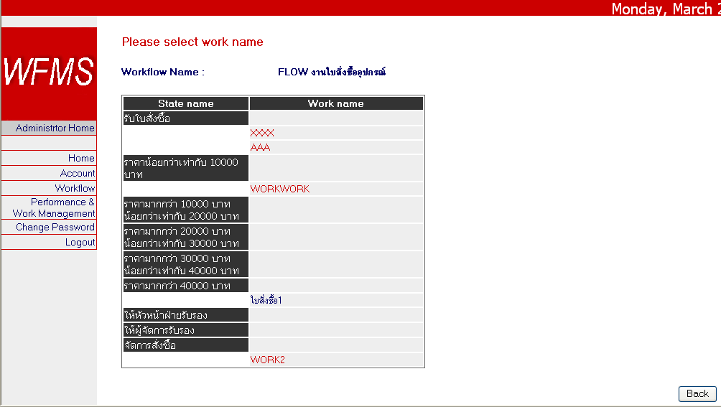
Tracking and Monitoring Tool
Monitoring Tool
Performance
  Select Workflow
  Select State & Time interval
  View Performance
Work Management
  Select Workflow
  Select State
  Force Work
Embedded System Laboratory, KMITL 2004

Slide 57
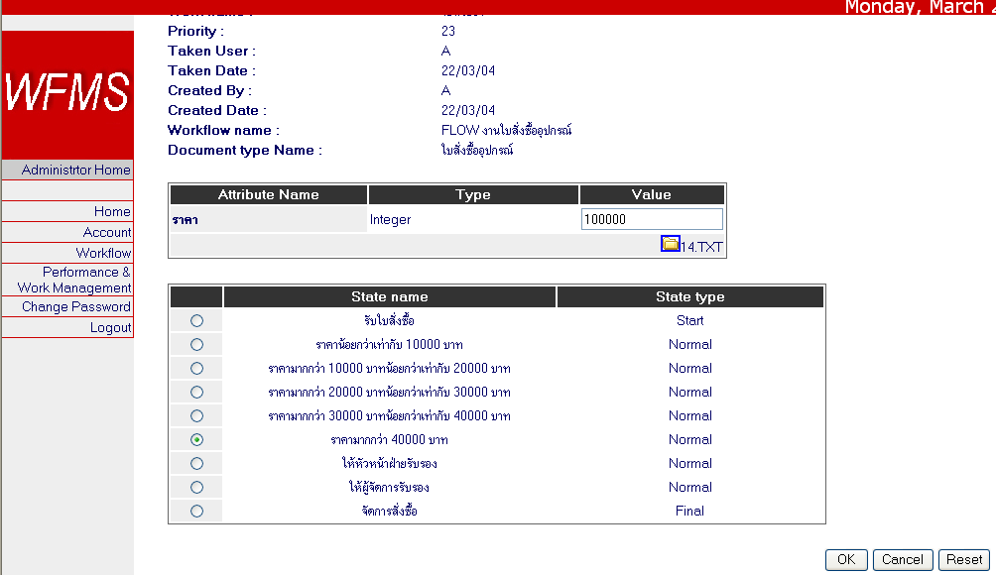
Tracking and Monitoring Tool
Monitoring Tool
Performance
  Select Workflow
  Select State & Time interval
  View Performance
Work Management
  Select Workflow
  Select State
  Force Work
Embedded System Laboratory, KMITL 2004

Slide 58
Summary
ผลที่ได้รับ
ปัญหาในการดำเนินโครงงาน
แนวทางการพัฒนาต่อ
Embedded System Laboratory, KMITL 2004

Slide 59
ผลที่ได้รับ
WFMS Engine
Admin Definition Tool
Client Application Workflow
Administration and monitoring tool
Embedded System Laboratory, KMITL 2004

Slide 60
ปัญหาในการดำเนินโครงงาน
Workflow ส่วนใหญ่ไม่ implement ตามข้อกำหนดของ มาตรฐาน
JDBC Driver ไม่สนับสนุนบางฟังก์ชันตามมาตรฐาน
Embedded System Laboratory, KMITL 2004

Slide 61
แนวทางในการพัฒนาต่อ
พัฒนาส่วนตรวจสอบในการสร้าง Condition
เพิ่มฟังก์ชั่นการส่งจดหมายเล็กทรอนิกส์
การพัฒนาหน้าเพ็จสำหรับใช้งาน (User Interface) เพื่อให้ใช้งานง่ายขึ้น
พัฒนาส่วน Invoked Application
พัฒนาส่วน Workflow Engine(s) Enactment
พัฒนาให้สามารถ import work มาจากเอกสาร XML ได้
Embedded System Laboratory, KMITL 2004

Slide 62

Question
Embedded System Laboratory, KMITL 2004

